Slide 1
How to View Waveforms Triggered by Frequency Setpoint & Transient using PMC Setup for PMC-660
Feb, 2014

Slide 2
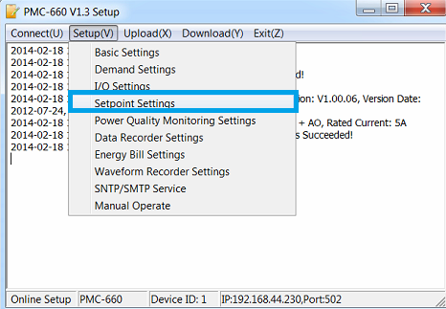
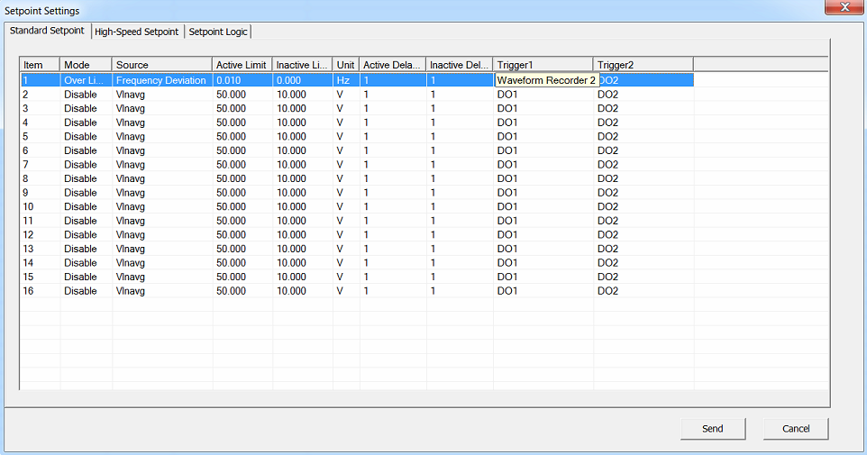
Frequency Setpoint Settings
Step 1. Click Setup→Setpoint Settings, navigate to Standard Setpoint, double-click Item 1, set Mode to Over Limit, set Source to Frequency Deviation, set Active Limit to 0.1, set Inactive Limit to 0, set Active Delay and Inactive Delay accordingly, set Trigger1 to Waveform Recorder 2.
Note: In order to trigger frequency setpoint, you should set Active Limit according to real-time frequency.

Slide 3
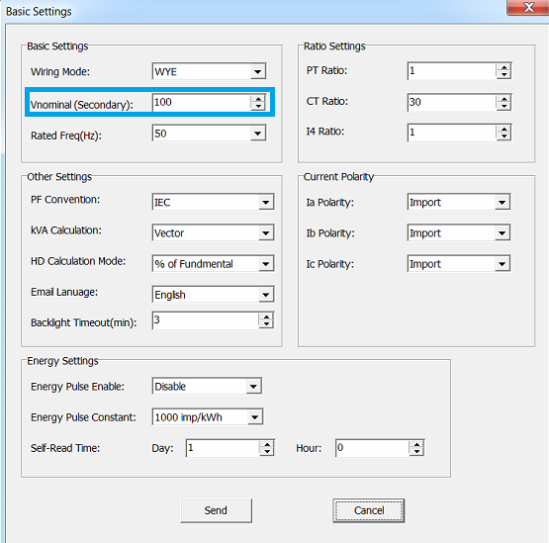
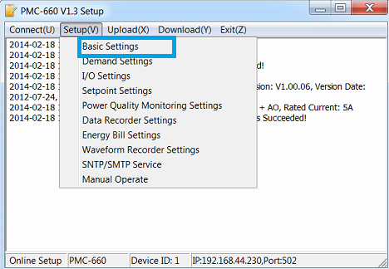
Transient Settings
Step 1. Use PMC Setup to connect to the PMC-660 meter. Click Setup→Basic Settings, set Vnominal(Secondary) correctly.
Note: In order to trigger transient , you should set Vnominal according to real-time voltage and transient limit.

Slide 4
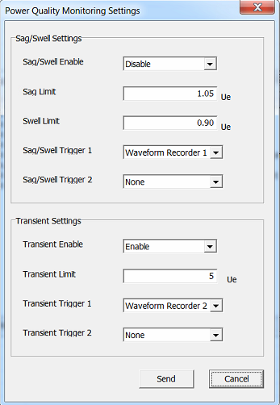
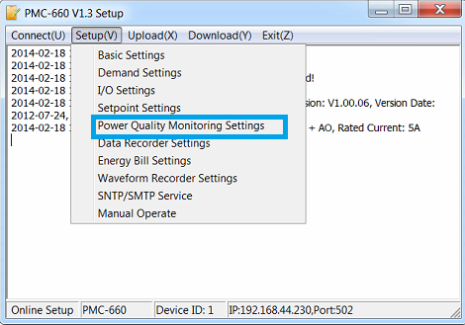
Transient Settings
Step 2. Click Setup→Power Quality Monitoring Settings, set Transient Enable to Enable, set Transient Limit properly, and set Transient Trigger 1 to Waveform Recorder 2.

Slide 5
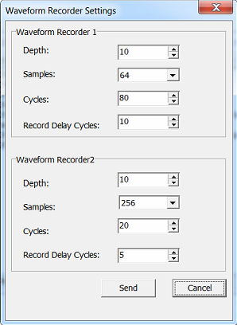
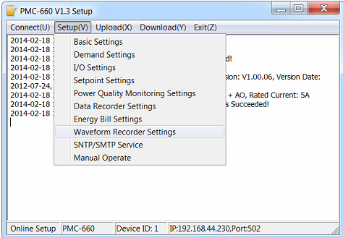
Waveform Settings
Step 3. Click Setup→Waveform Recorder Settings, set Depth to 10, set Samples to 256, set Cycles to 20, and set Transient Trigger 1 to 5 for Waveform Recorder 2.
Note: PMC Setup can only read the waveforms stored in the memory. The waveforms are stored in Circular mode. When reach the depth, the oldest waveform will be overwritten.

Slide 6
Energize the Meter
Make sure the meter is energized, and real-time voltage and frequency reach the limit.

Slide 7
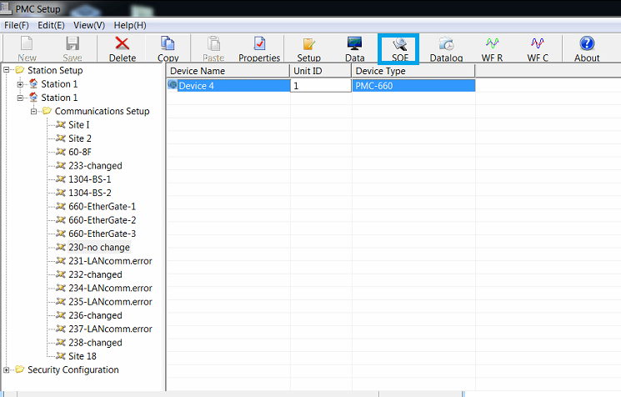
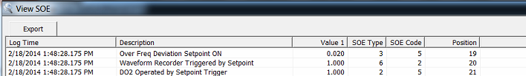
View SOEs related to Frequency Setpoint
Step 1. Click SOE from the toolbar, all SOEs stored in the meter will be displayed. If the frequency setpoint is triggered, there will be SOEs shown as below:

Slide 8
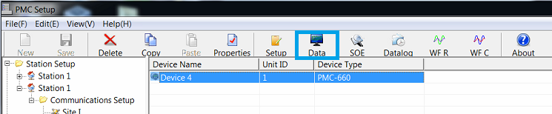
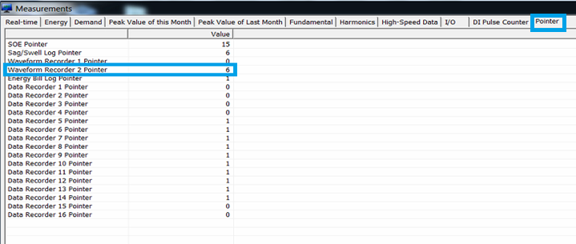
View Pointer related to Frequency Setpoint
Step 1. Click Data from the toolbar, navigate to Pointer, read the value of Waveform Recorder 2 Pointer. The waveform recorder pointer indicates how many waveforms are stored. When a new waveform is triggered, the pointer will increase 1.

Slide 9
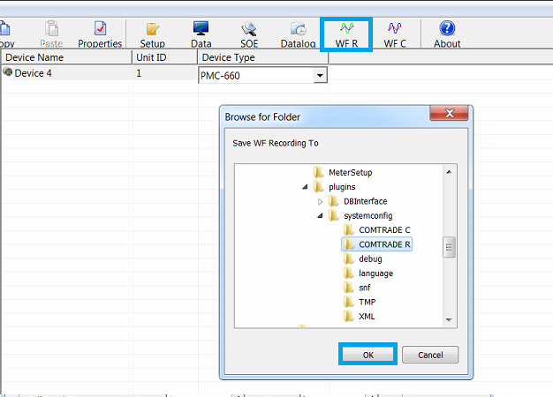
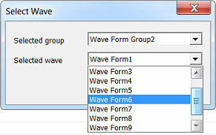
View Waveforms related to Frequency Setpoint
Step 1. Click WF R from the toolbar, it automatically locates to the COMTRADE R folder, click OK.
Step2. The Select Wave window appears. Select Waveform Group 2, and select the responding waveform number(for example, waveform recorder 2 pointer=6, so we select waveform6).
Note: Please select waveform group as the setting, then choose the related waveform.

Slide 10
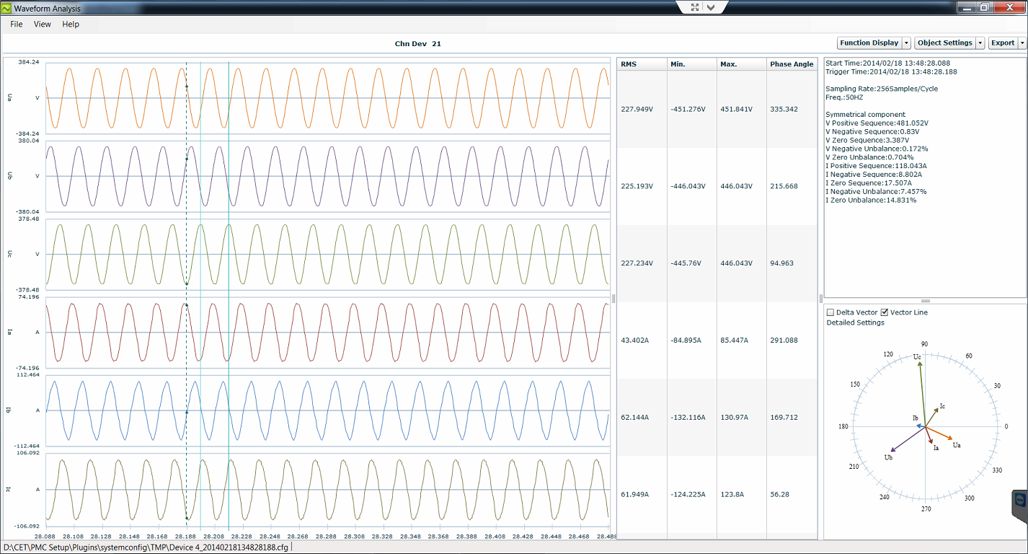
View Waveforms related to Frequency Setpoint
Step 2. The waveform triggered by frequency setpoint is displayed as below.

Slide 11
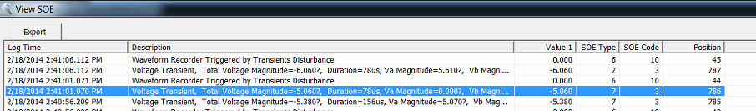
View SOEs related to Transient
Step 1. Click SOE from the toolbar, all SOEs stored in the meter will be displayed. If the transient is triggered, there will be SOEs shown as below:

Slide 12
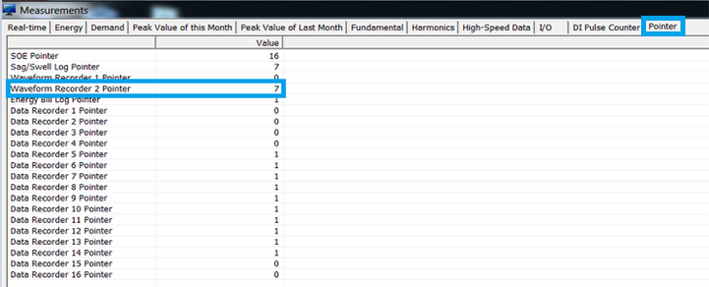
View Pointer related to Transient
Step 1. Click Data from the toolbar, navigate to Pointer, read the value of Waveform Recorder 2 Pointer. The waveform recorder pointer indicates how many waveforms are stored. When a new waveform is triggered, the pointer will increase 1.

Slide 13
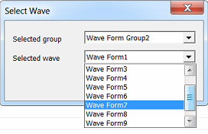
View Waveforms related to Transient
Step 1. Click WF R from the toolbar, it automatically locates to the COMTRADE R folder, click OK.
Step2. The Select Wave window appears. Select Waveform Group 2, and select the responding waveform number(for example, waveform recorder 2 pointer=7, so we select waveform7).
Note: Please select waveform group as the setting, then choose the related waveform.

Slide 14
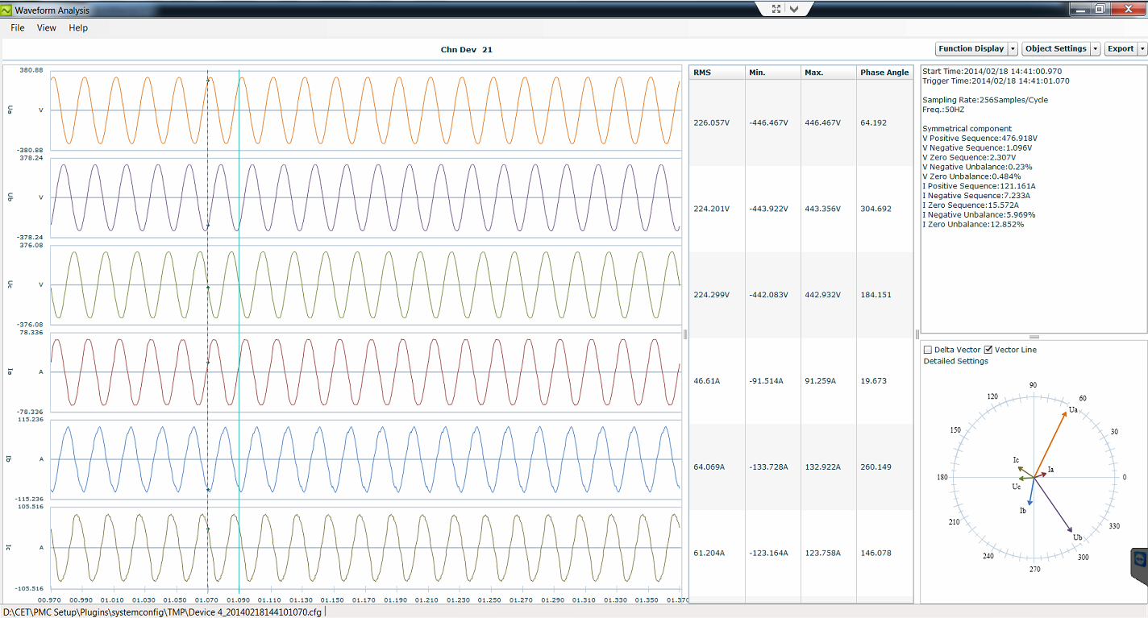
View Waveforms related to Transient
Step 3. The waveform triggered by transient is displayed as below.

Slide 15
Thank You

